Slide 1
MATHEMATICS FOR ENGINEERING

Slide 2
Evaluation Strategy
Must attend more than 80% of contact hours
Evaluating
03 Progress tests: → 30%
03 Assignments: → 30%
Final Exam (FE): → 40%
Pass: Every on-going assessment component > 0
and Final Exam score ≥ 4 (of 10)
and Final Result ≥ 5
Retake only the Final Exam when not passed

Slide 3
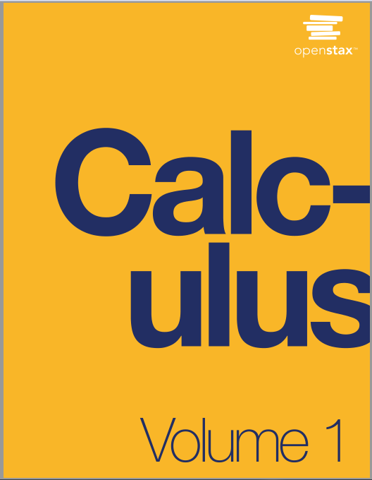
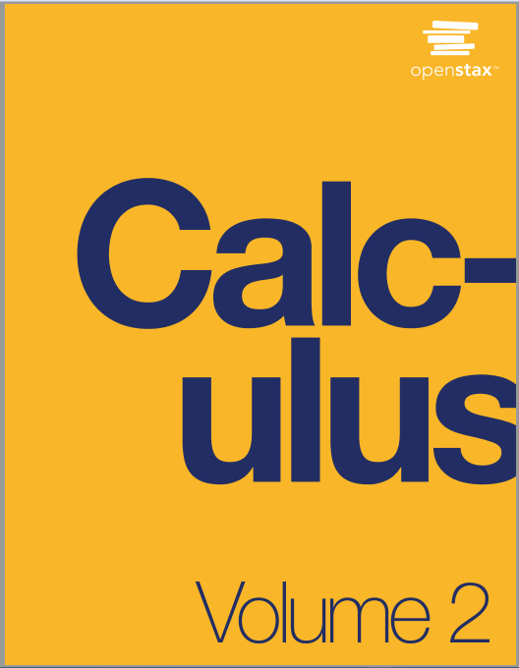
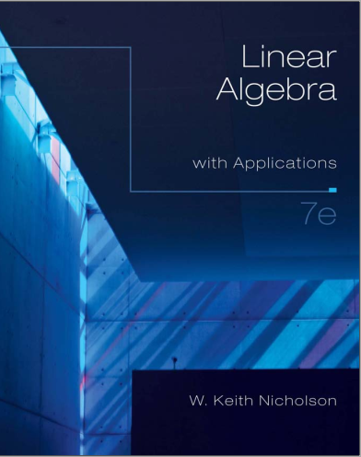
Materials
Notes:
the importance of basic elementary functions, limits and continuity

Slide 4
Course description
Chapter 1: Functions and Graphs
Chapter 2: Limits
Chapter 3: Derivatives
Chapter 4: Applications of Derivatives
Chapter 5: Integration
Chapter 6: Techniques of Integrations
Chapter 1: System of Linear Equations
Chapter 2: Matrix Algebra
Chapter 3: Determinants and Diagonalization
Chapter 4: Vector geometry
Chapter 5: The vector space R^n

Slide 5

Functions and Graphs

Slide 6
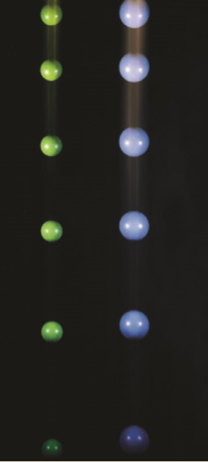
Why study this chapter?
Calculus is the mathematics that describes changes in functions.
For example, a ball falls faster and faster as time passes. Galileo discovered that the distance fallen is proportional to the square of the time it has been falling. Calculus then enables us to calculate the speed of the ball at any time.
The fundamental objects that we deal with in calculus are functions.
Functions are used as mathematical models of real-world phenomena.

Slide 7
Learning objectives
Determine the domain, range, and zeros of a function.
Analyze the symmetry of the graph of a function.
Create new functions from old functions.

Slide 8
FUNCTION
A function f is a rule that assigns to each element x in a set D exactly one element, called f(x), in a set E.
The set D is called the domain of the function f.
The range of f is the set of all possible values of f(x) as x varies throughout the domain.

Slide 9
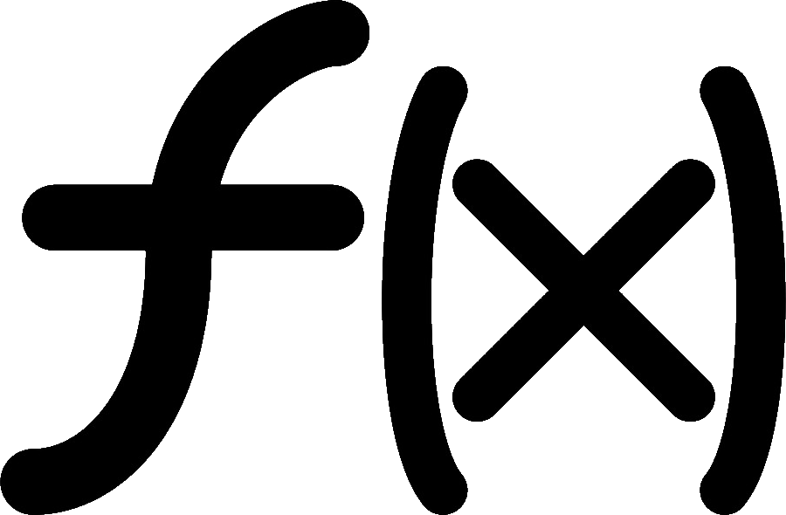

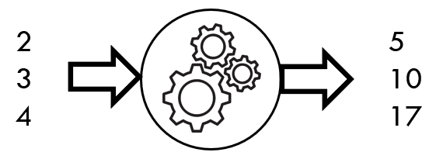
functions (= special rules)
⇨
⇨
Input | Output
2 | 5
3 | 10
4 | 17
Input
x
Output
y
•
•
f = {(2, 5), (3, 10), (4, 17)}
•
f(x) = x² + 1
x ∈ {2, 3, 4}

Slide 10
Functions – example
f(x) = x²
Rule: output is square of input
Input
Output

Slide 11
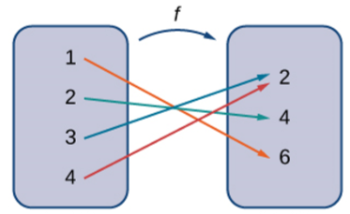
Functions – example
Input: 1, 2, 3, 4
Output: 2, 4, 6
Rule:
* 1 maps to 6
* 2 maps to 4
* 3 maps to 2
* 4 maps to 2

Slide 12
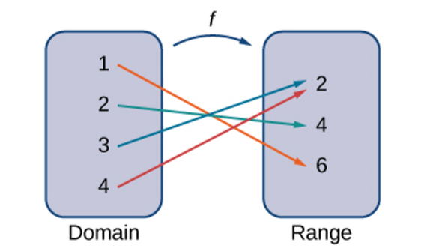
Domain and range

Slide 13
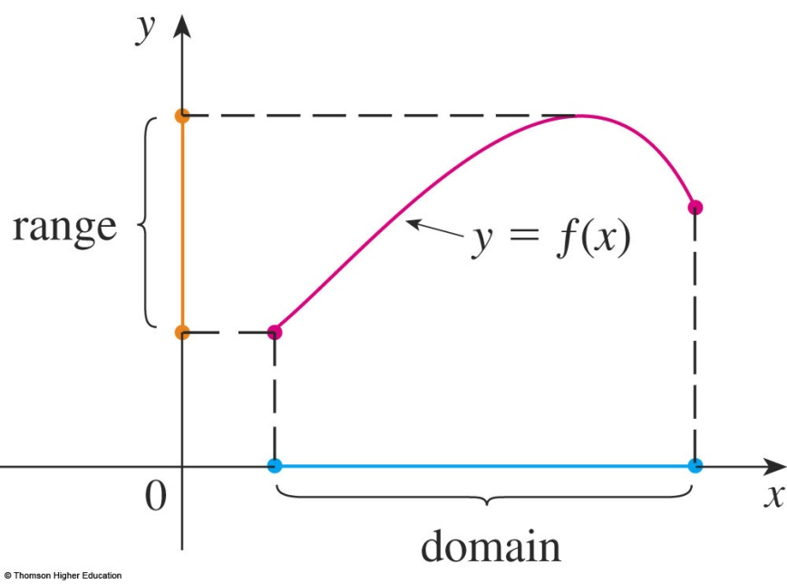
GRAPH
The graph of f is the set of all points (x, y) in the coordinate plane such that y = f(x) and x is in the domain of f.
The graph of f also allows us to picture:
The domain of f on the x-axis
Its range on the y-axis
Notes:
Perpendicular projection of the graph to the Ox is domain
Perpendicular projection of the graph to the Oy is range

Slide 14
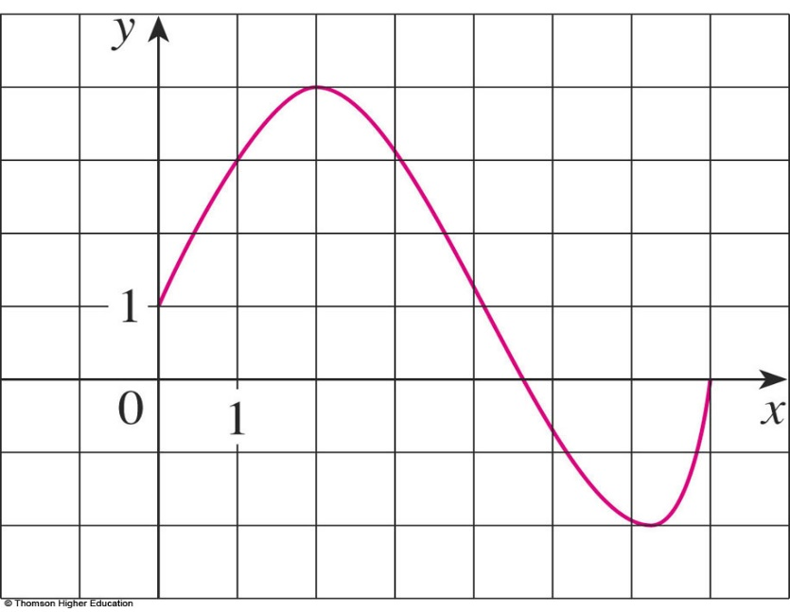
GRAPH
Example 1
The graph of a function f is shown.
Find the values of f(1) and f(5).
What is the domain and range of f ?
f(1) = 3
f(5) = - 0.7
D = [0, 7]
Range(f) = [-2, 4]

Slide 15

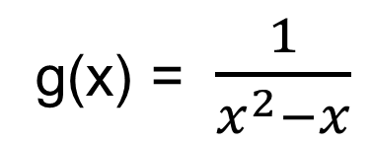
Example
Find the domain and region of the functions
(if it is a function)
a.
b.

Slide 16
Zeros of a function
If f(a) = 0, then a is called a zero of f.
Ex. Find all zeros of f(x) = x³ - 3x² + 2x.
x³ - 3x² + 2x = 0 ⇔ x = 0, x = 1, x = 2.
➔ Zeros of f are: 0, 1, 2

Slide 17
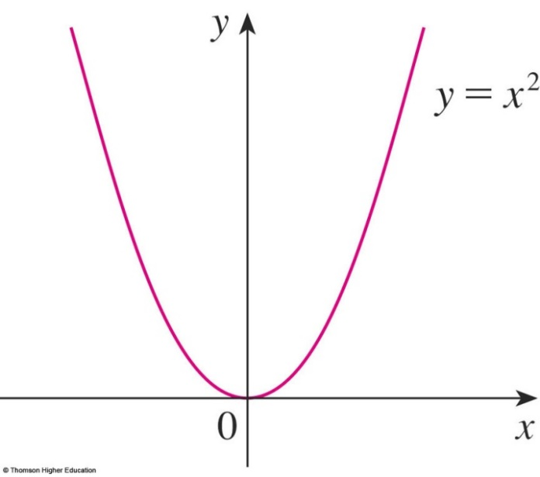
Symmetry of even functions
If f(-x) = f(x) for all x in domain
➔ f is an even function
➔ symmetry about the y-axis.
Symmetry about y-axis

Slide 18
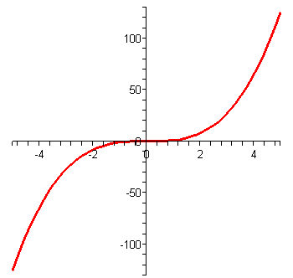
Symmetry of odd functions
If f(-x) = -f(x) for all x in domain
➔ f is an odd function
➔ symmetry about the origin
y = x³
Symmetry about the origin

Slide 19
Example
Let f be an odd function. If the point (-3, 5) is on the graph of f, then which of the following points is/are also on the graph of f?
a.(3, 5) b.(-3, -5) c.(3, -5) d. None of these
✓

Slide 20
Odd or even or neither?
1/ f(x) = x² - 3
2/ g(x) = x³ + 4x
3/ h(x) = 3x/(x² + 4)
4/ k(x) = x⁴ - x

Slide 21
Combinations of Functions
f + g
f - g
f.g
f/g (g ≠ 0)

Slide 22

Composite function g□f
Input
x
Function
f
Function
g
Output
y
function g□f
f
g
Ex. x 3 - x (3 - x)²
g(x) =

Slide 23
Composite functions – example
Given f(x) = x + 5 and g(x) = x², find g□f and f□g.
(g□f)(x) = g(f(x)) = g(x + 5) = (x + 5)².
( x  x + 5  (x + 5)² )
(f□g)(x) = f(g(x)) = f(x²) = x² + 5.

Slide 24
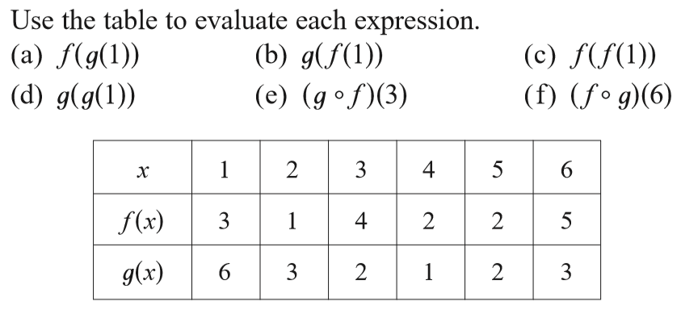
Composite functions – example
f(g(1)) = f(6) = 5
1  6  5
(e) (g□f)(3) = g(f(3))
g
f

Slide 25
Let h(x)=f(g(x)).
If g(x)=x-1 and h(x)=3x+2 then f(x) is:
3x+3 b. 3x+4 c. 3x+2 d. 3x+5
2) If h(x)=3x+2 and f(x)=x-1 then g(x) is:
a. 3x+2 b. 3x+4 c.3x+3 d. 3x+1
Answer: 1) d 2) c

Slide 26
QUIZ QUESTIONS
If f and g are functions, then
True b. False
2)
is
a. 5 b. 1 c. 2 d. None of the others
.
x | 1 | 2 | 3 | 4 | 5 | 6
 | 3 | 2 | 1 | 0 | 1 | 2
 | 6 | 5 | 2 | 3 | 4 | 6

Slide 27
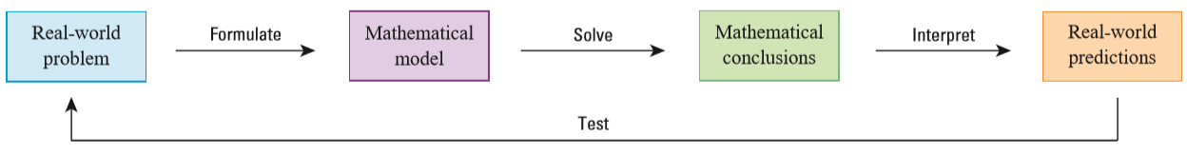
Common mathematical models
Linear models Polynomials
Power Functions Rational Functions
Trigonometric Functions Exponential Functions
Logarithmic Functions

Slide 28
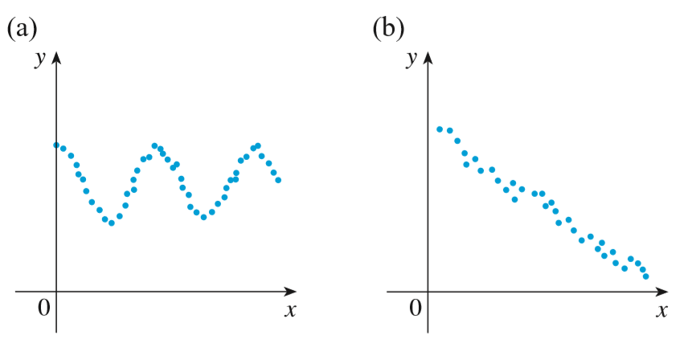
Choose a reasonable model
For each scatter plot, decide what type of function you might choose as a model for the data.

Slide 29
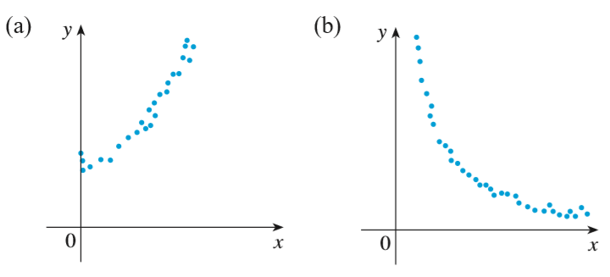
Choose a reasonable model
For each scatter plot, decide what type of function you might choose as a model for the data.

Slide 30
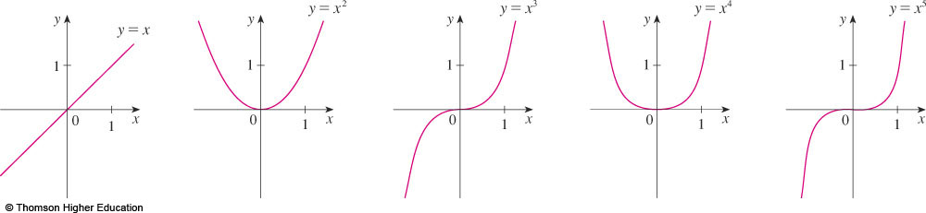
ALGEBRAIC FUNCTIONS
POWER FUNCTIONS
A function of the form f(x) = x ª , where a is constant, is called a power function.

Slide 31
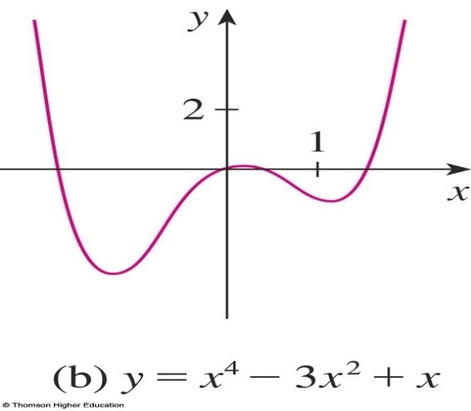
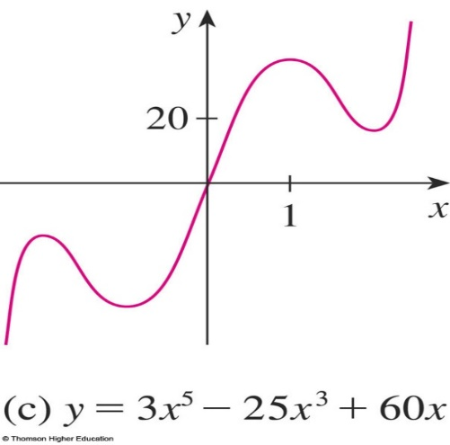
ALGEBRAIC FUNCTIONS
POLYNOMIALS
A function P is called a polynomial if
P(x) = a_{n}x^{n} + a_{n-1}x^{n-1} + … + a₂x² + a₁x + a₀
where a_{i} are the coefficients of the polynomial.
Notes:
a_{n} ≠0

Slide 32
ALGEBRAIC FUNCTIONS
RATIONAL FUNCTIONS
A rational function f is a ratio of two polynomials
where P and Q are polynomials. The domain consists of all values of x such that
Notes:
P and Q are polynomials

Slide 33
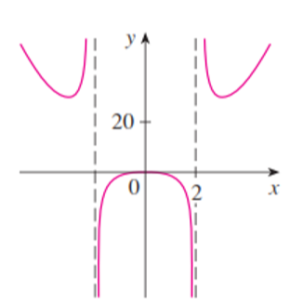
ALGEBRAIC FUNCTIONS
RATIONAL FUNCTIONS
Notes:
P and Q are polynomials

Slide 34
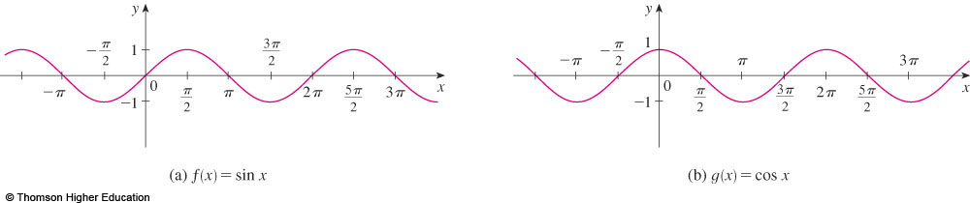
TRANSCENDENTAL FUNCTIONS (Hàm siêu việt)
TRIGONOMETRIC FUNCTIONS
f(x) = sin x
g(x) = cos x
R = [-1, 1]
Notes:
Hàm siêu việt
Sin(-x)=-sinx
Cos(-x) = cosx
R = [-1, 1]

Slide 35
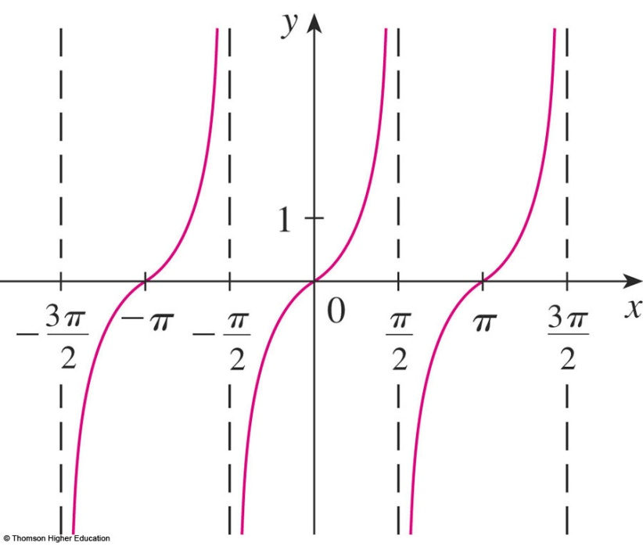
TRANSCENDENTAL FUNCTIONS
TRIGONOMETRIC FUNCTIONS
Notes:
Range = (-∞,∞)

Slide 36
TRANSCENDENTAL FUNCTIONS
TRIGONOMETRIC FUNCTIONS
The reciprocals of the sine, cosine, and tangent functions are

Slide 37
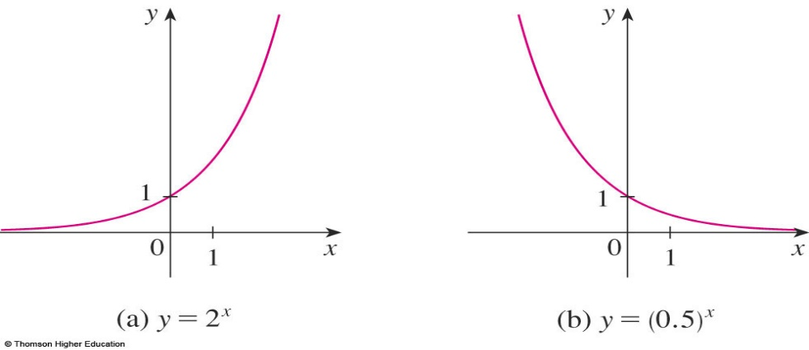
TRANSCENDENTAL FUNCTIONS
EXPONENTIAL FUNCTIONS
The exponential functions are the functions of the form , where the base a is a positive constant.
The graphs of y = 2^{x} and y = (0.5)^{x} are shown.
In both cases, the domain is and the range is .
Notes:
Domain?
Range?
Graph when a>1; a<1

Slide 38
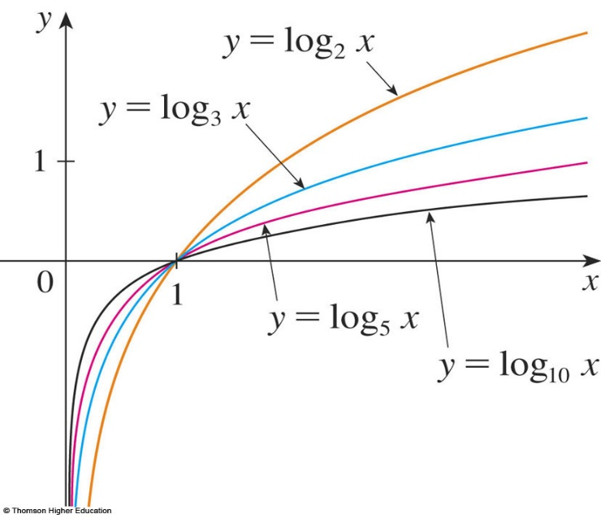
TRANSCENDENTAL FUNCTIONS
LOGARITHMIC FUNCTIONS
The logarithmic functions ,
where the base a is a positive constant, are the inverse functions of the exponential functions.
The figure shows the graphs of four logarithmic functions with various bases.
Notes:
0<a≠1; x>0

Slide 39

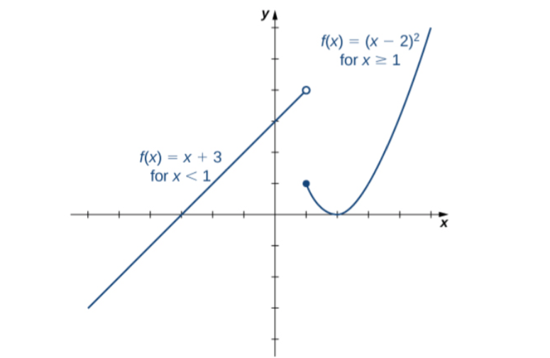
PIECEWISE-DEFINED FUNCTIONS
Example:
Notes:
PIECEWISE

Slide 40
New functions from old functions
Shifting
Reflections

Slide 41
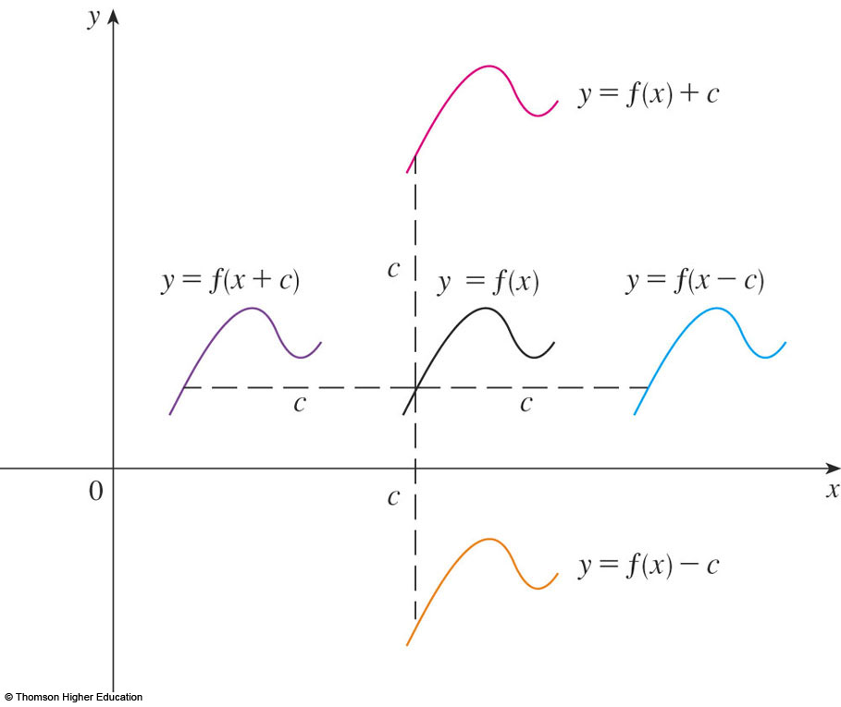
Shifting
(Suppose c > 0)
f(x) ⇒ f(x) + c: shift the graph of
y = f(x) c units upward.
f(x) ⇒ f(x - c): shift the graph of
y = f(x) c units to the right.
Notes:
f+c; f-c

Slide 42
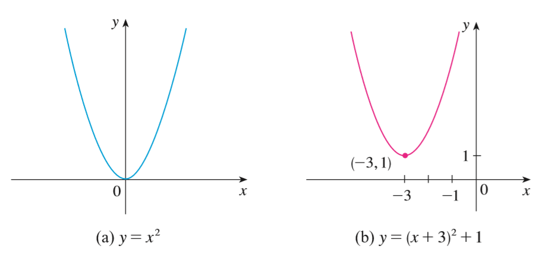
Shifting – example
Step 1. f(x) ⇒ f(x + 3)
Step 2. f(x) ⇒ f(x+3) + 1

Slide 43
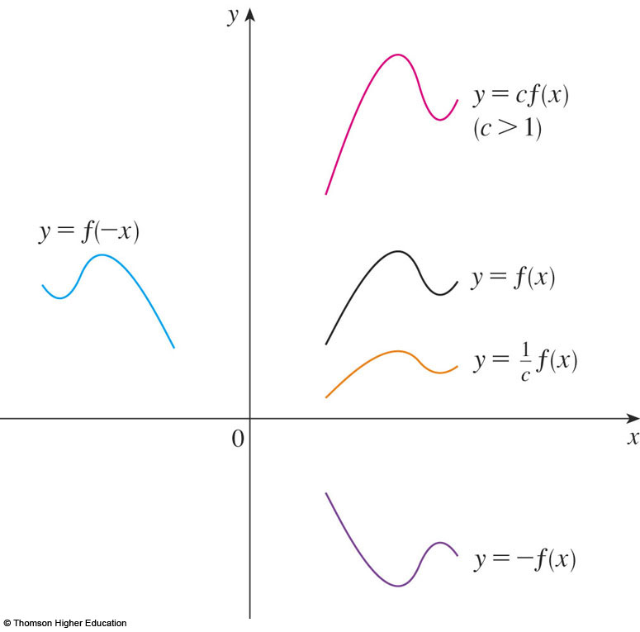
TRANSFORMATIONS
Suppose c > 1.
To obtain the gr of y = c f(x), stretch the graph of y = f(x) vertically by a factor of c.
To obtain the graph of
y = (1/c)f(x), compress the graph of y = f(x) vertically by a factor of c.
How about the case c<1?

Slide 44
TRANSFORMATIONS
To obtain the graph of y = f(cx), compress the graph of y = f(x)
horizontally by a factor of c.
To obtain the graph of y = f(x/c), stretch the graph of y = f(x) horizontally by a factor of c.

Slide 45
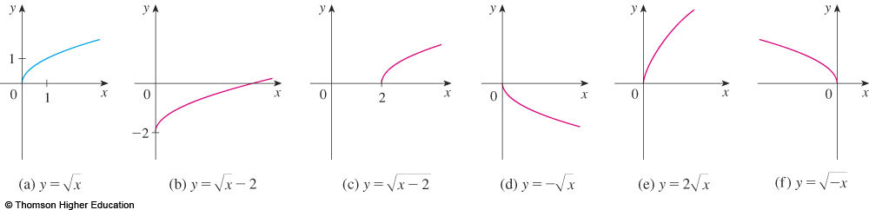
NEW FUNCTIONS FROM OLD FUNCTIONS
Label the following graph from the graph of
the function shown in the part (a):
y=f(x)-2, y=f(x-2), y=-f(x), y=2f(x), y=f(-x)?
by reflecting about the x-axis.
by stretching vertically by a factor of 2.
by reflecting about the y-axis

Slide 46
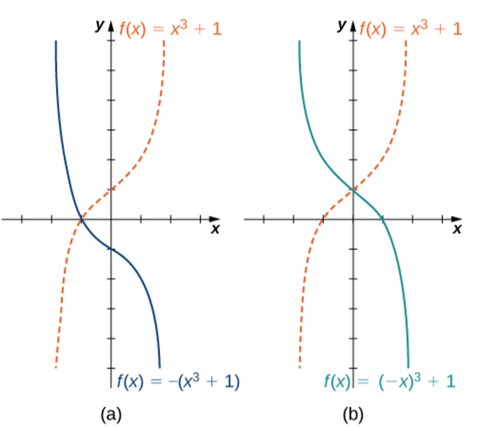
Reflections
f(x) ⇒ −f(x): reflect the graph of y= f(x) about the x-axis.
(b) f(x) ⇒ f(−x): reflect the graph of y= f(x) about the y-axis.
f(x) ➔ -f(x)
f(x) ➔ f(-x)

Slide 47

f(x) ⇒ |f(x)| rule
Keep the part of the graph when it lies above x-axis.
Reflect the part below x-axis about the x-axis.

Slide 48
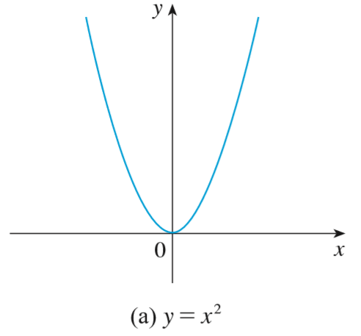
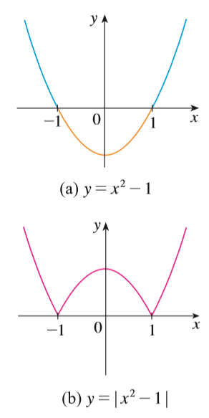
f(x) ⇒ |f(x)|
Ex. Sketch the graph of the function y = |x² - 1|.
Step 1. Graph y = x².
Step 2. Shift 1 unit down.
Step 3. Apply f(x) ⇒ |f(x)| rule.

Slide 49
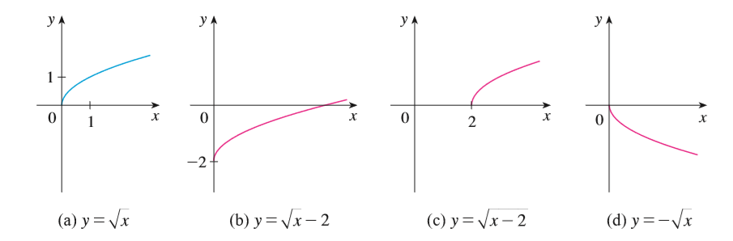
Transformations - Quiz

Slide 50
Exercise
1/ Suppose the graph of y = f(x) is given. How can we obtain the graph of y = f(x + 3) + 2?
2/ Describe how the function f(x)= −(x+1)² − 4 can be graphed using the graph of y= x² and a sequence of transformations.

Slide 51
True-False Quiz
If is a function, then f(a + b) = f(a) + f(b).
If is a function, then f(3x) = 3f(x).
Shift the graph of f to the right 3 units to obtain the graph of f(x + 3).
If f is odd, then f(x) + f(-x) = 0.
f□g = g□f, assuming f and g are functions.

Slide 52
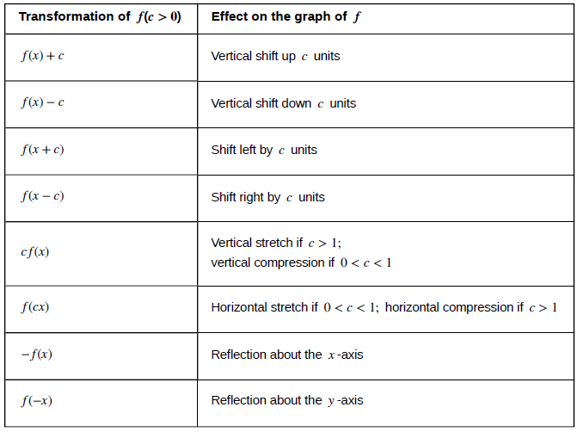

Slide 53
Example
Suppose that the graph of f is given.
Describe how the graph of the function f(x-2)+2 can be obtained from the graph of f.
Select the correct answer.
a. Shift the graph 2 units to the left and 2 units down.
b. Shift the graph 2 units to the right and 2 units down.
c. Shift the graph 2 units to the right and 2 units up.
d. Shift the graph 2 units to the left and 2 units up.
e. none of these
Answer: c

Slide 54

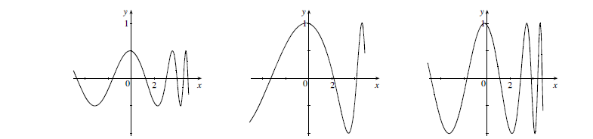
QUIZ QUESTIONS
Answer: ½ f(x), f(½ x), f(x)

Slide 55
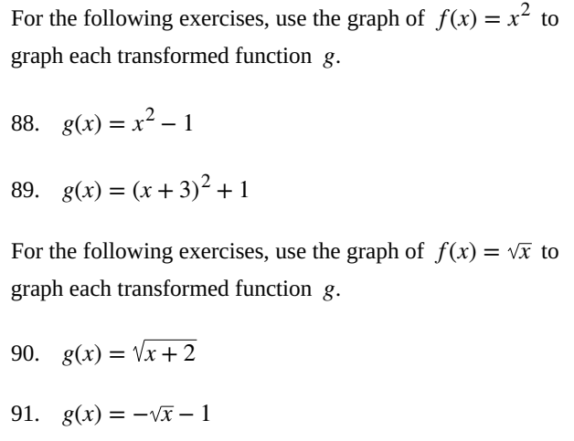

Slide 56
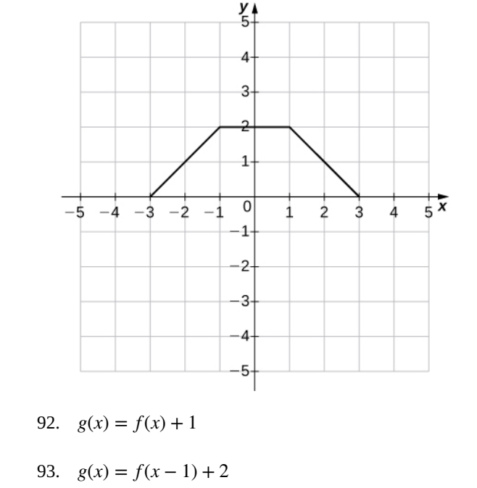

Slide 57
Summary
Function: a set of inputs, a set of outputs, and a rule for mapping each input to exactly one output.
Zeros of f: solutions of the equation f(x) = 0.
Odd function: f(−x)= −f(x) for all x in the domain of f.
Even function: f(−x)= f(x) for all x in the domain of f.
Transformations of functions: shifting, reflections.
Composition of functions: (g□f)(x):= g(f(x)).

Slide 58
THANKS

